Slide 1

WAY TO ENTERPRISE
AWS
VTI ACADEMY
Author: duy.nguyenngoc1@vti.com.vn

Slide 2
Agenda
AWS Security
AWS Shield
Web Application Firewall Service
AWS Firewall Manager
GuardDuty Service
Inspector Service
Macie Service
Shared Responsibility Model
Copyright © VTI Academy All Rights Reserved

Slide 3
AWS Security
Web attacking types
  SQL Injection
  XSS
  Denial-of-Service (DoS) attack
  HTTP Flood attack

Slide 4
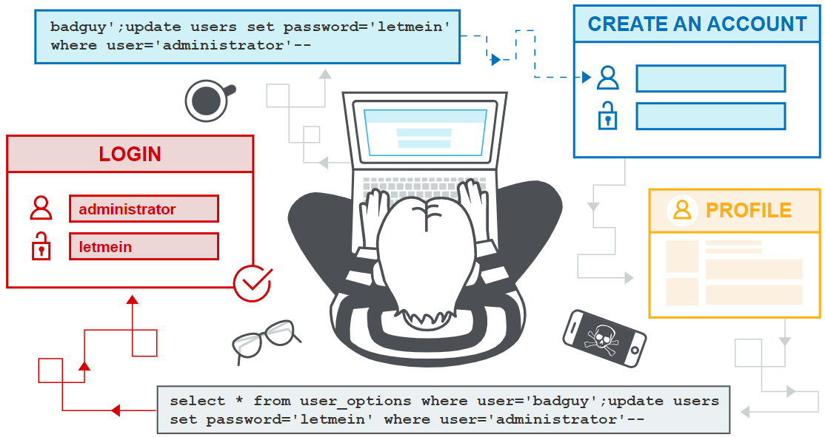
AWS Security
  SQL Injection
    SQL injection is a web security vulnerability that allows an attacker to interfere with the queries that an application makes to its database
    It generally allows an attacker to view data that they are not normally able to retrieve
Tutorial: https://portswigger.net/web-security/sql-injection

Slide 5
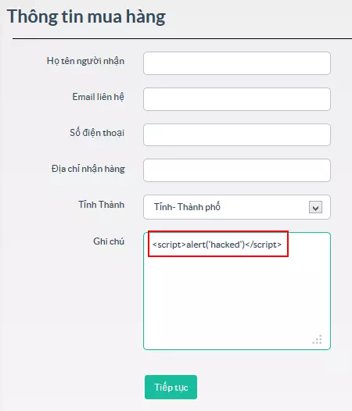

AWS Security
  XSS
    Stands for cross-site scripting
    HTML Injection
    Is a malicious code injection, which will be executed in the victim’s browser
    The purpose of this attack is to steal the other user’s identity data (cookies, session tokens, other information)
    3 types: Reflected XSS, Stored XSS, DOM XSS
Tutorial: https://www.softwaretestinghelp.com/cross-site-scripting-xss-attack-test

Slide 6
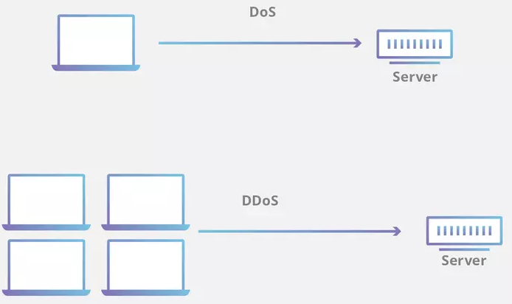
AWS Security
  Denial-of-Service (DoS) attack
    An attack meant to shut down a machine or network, making it inaccessible to its intended users.
    DoS attacks accomplish this by flooding the target with traffic, or sending it information that triggers a crash
    2 types
      Flooding attack: Buffer overflow attacks, ICMP flood, SYN flood
      Crashing attack
Tutorial: https://www.paloaltonetworks.com/cyberpedia/what-is-a-denial-of-service-attack-dos

Slide 7
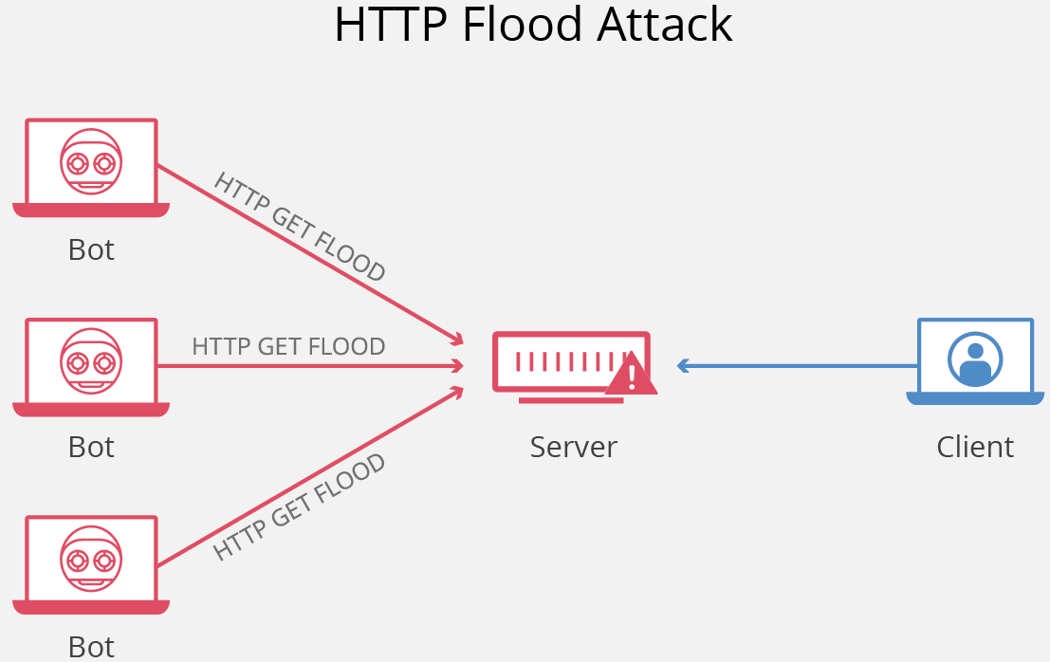
AWS Security
  HTTP Flood attack
    An HTTP flood attack is a type of volumetric distributed denial-of-service (DDoS) attack designed to overwhelm a targeted server with HTTP requests
    Once the target has been saturated with requests and is unable to respond to normal traffic, denial-of-service will occur for additional requests from actual users
    2 types:
      HTTP GET attack
      HTTP POST attack
Tutorial: https://www.cloudflare.com/learning/ddos/http-flood-ddos-attack/

Slide 8
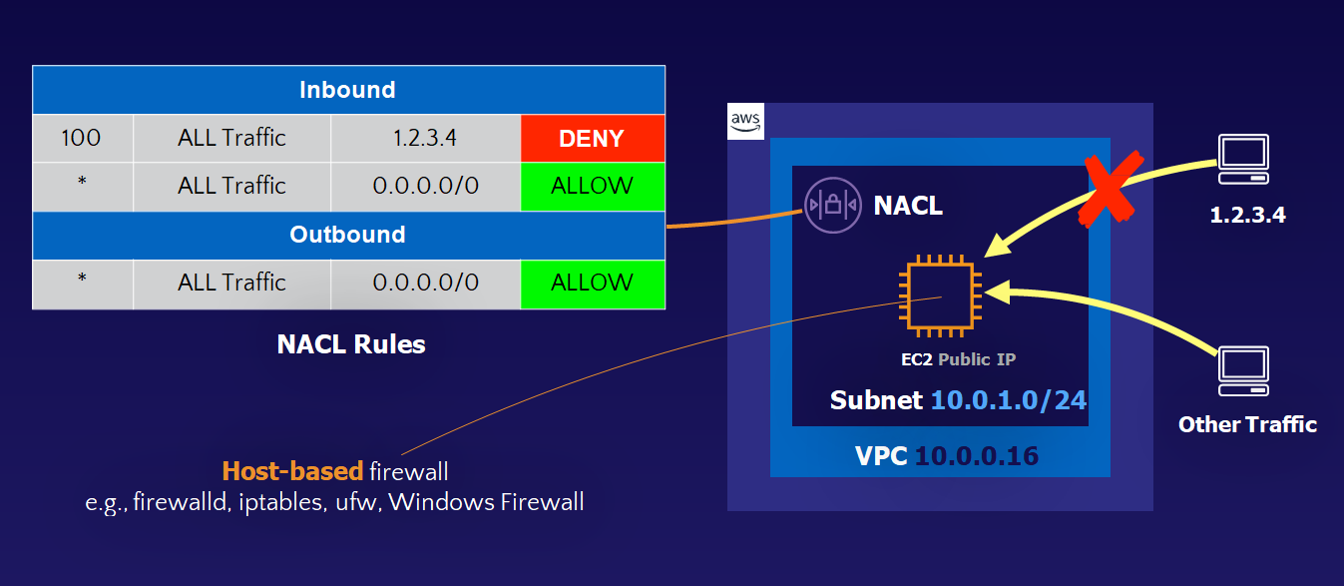
AWS Security
Fix
  NACL & Security Group
  AWS Shield
  Web Application Firewall Service
  AWS Firewall Manager
NACL & Security Group

Slide 9
Assignment
  Self-practice

Slide 10
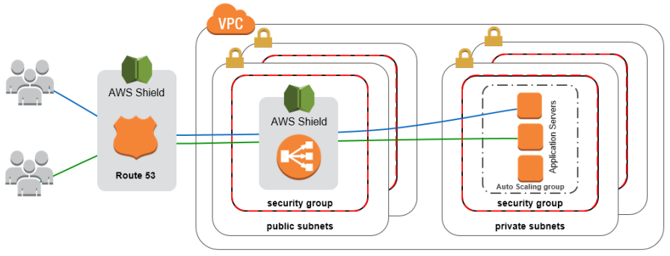
AWS Shield
Shield allows to prevent DDoS attacks on AWS resources
Price: https://aws.amazon.com/shield/pricing
Tutorial: https://docs.aws.amazon.com/waf/latest/developerguide/shield-chapter.html

Slide 11
AWS Shield
2 types: Shield Standard, Shield Advanced
  Shield Standard
    Automatically enabled in Cloudfront & ELB
    Working on layer 3, 4
    Free
  Shield Advanced
    Enhanced protection for EC2, ELB, CloudFront, Global Accelerator, Route 53
    Working on layer 3, 4, 7
    Protect against higher fees during usage spikes due to DDoS
    Health check
    Support 24/7 when attacked
    $3,000 per month per organization

Slide 12
AWS Shield
Demo
  https://www.youtube.com/watch?v=b1rOUehg4XA

Slide 13
Assignment
  Self-practice

Slide 14
Web Application Firewall Service
WAF is a service that allows to
  Prevent common web exploits (Layer 7) on AWS resources
  Monitoring HTTP & HTTPS requests
  Allow/block users to access the Application based on IP Address, country, query string, ...
Price: https://aws.amazon.com/waf/pricing
Tutorial: https://docs.aws.amazon.com/waf/latest/developerguide/what-is-aws-waf.html

Slide 15
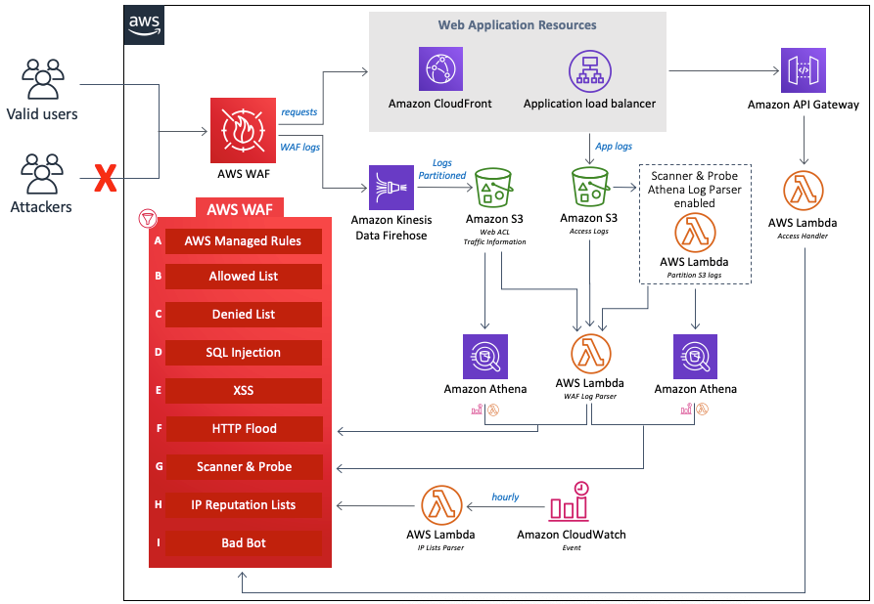
Web Application Firewall Service

Slide 16
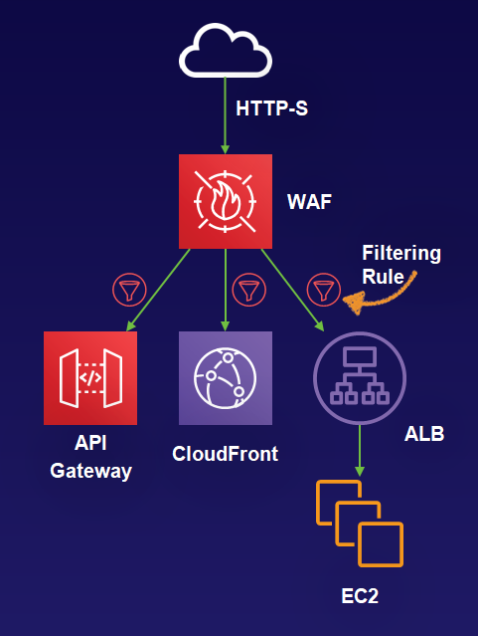
Web Application Firewall Service
Define Web ACLs (web access control lists)
  Resource: attach to CloudFront, API Gateway, ALB, EC2, …
  Rules:
    Country, IP addresses, HTTP headers, HTTP body, Query string, Request count, ...
    Allow / Block
    2 types: Managed rule groups, Custom rule groups

Slide 17
Web Application Firewall Service
Demo
  https://www.youtube.com/watch?v=_-OHHAbw7c0
  https://www.youtube.com/watch?v=_M872LhrcD4

Slide 18
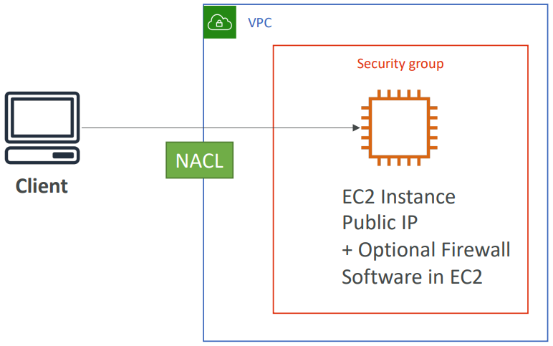
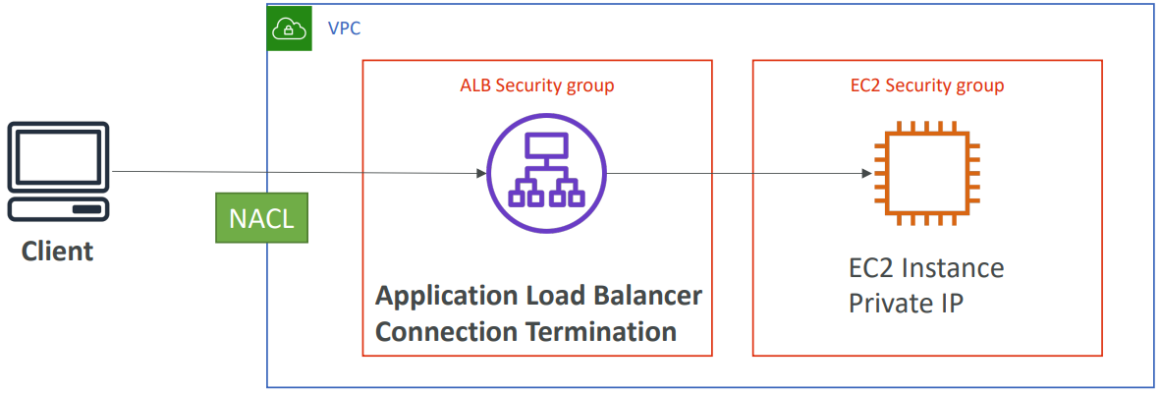
Web Application Firewall Service
Blocking an IP address
Using NACL

Slide 19
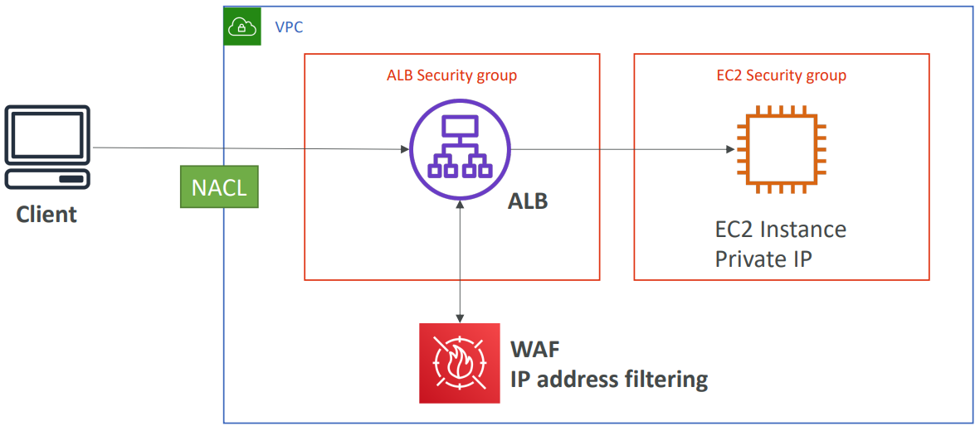
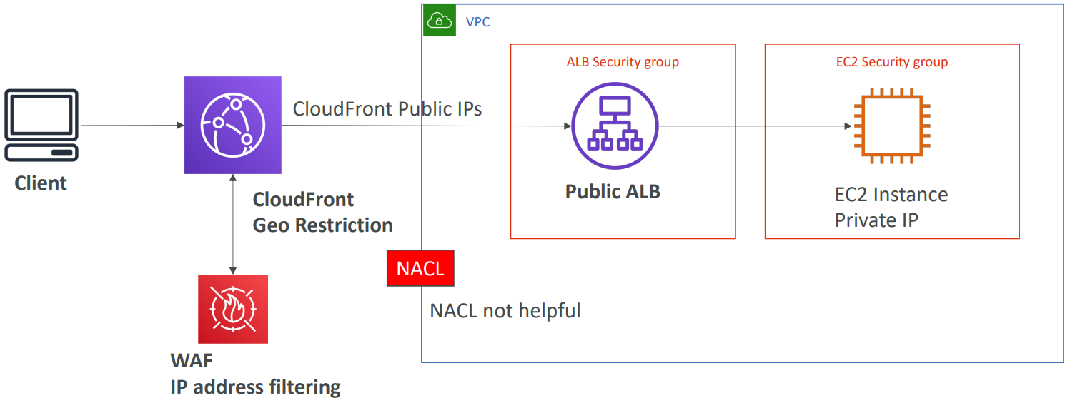
Web Application Firewall Service
Using NACL + WAF for ELB
Using WAF for CloudFront

Slide 20
Assignment
  Self-practice

Slide 21
AWS Firewall Manager
AFM allows to manage Firewall Rules, Shield Advanced, VPC Security Groups in all accounts of an AWS Organization
Usecases
  Allows member accounts of the Organization to use Shield Advanced
  Share Security Group Rule for all member accounts
3 types: Firewall Rules, Shield Advanced, VPC Security Groups
Price: https://aws.amazon.com/firewall-manager/pricing
Tutorial: https://docs.aws.amazon.com/waf/latest/developerguide/fms-chapter.html

Slide 22
AWS Firewall Manager
Demo
  https://www.youtube.com/watch?v=wocz0drq8-8

Slide 23
Assignment
  Self-practice

Slide 24
Other Service
GuardDuty Service
Inspector Service
Macie Service

Slide 25
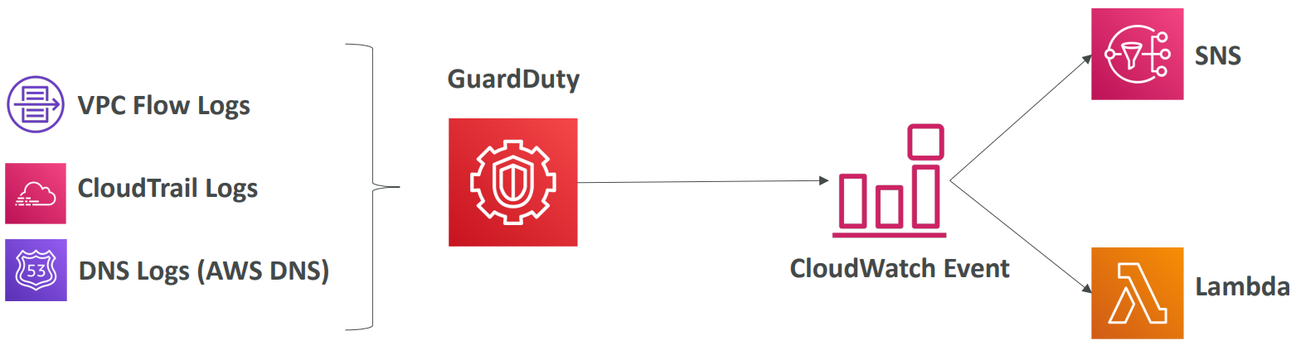
GuardDuty Service
Intelligent Threat discovery to Protect AWS Account
Uses Machine Learning algorithms, anomaly detection, 3rd party data based-on
  CloudTrail Logs: unusual API calls, unauthorized deployments
  VPC Flow Logs: unusual internal traffic, unusual IP address
  DNS Logs: compromised EC2 instances sending encoded data within DNS queries
Can setup CloudWatch Event to be notified in case of findings

Slide 26
GuardDuty Service
Can setup CloudWatch Event to be notified in case of findings
Finding types: EC2, IAM, S3, Kubernetes (Reference)
Price: 30 days trial, https://aws.amazon.com/guardduty/pricing
Demo: https://www.youtube.com/watch?v=o2YaIsps5LY
Tutorial: https://docs.aws.amazon.com/guardduty/latest/ug/what-is-guardduty.html

Slide 27
Assignment
  Self-practice

Slide 28
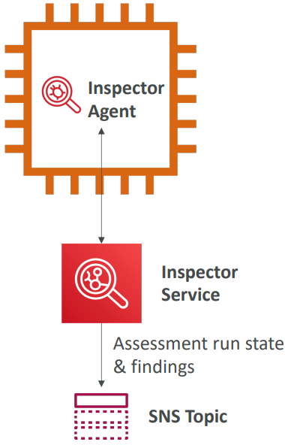
Inspector Service
Is an automated vulnerability management service that continually scans on EC2 instances and images (ECR)
  AWS workloads for software vulnerabilities
  Unintended network exposure
When a issue is discovered, Inspector creates a finding
  Issue types: Package vulnerability (Software), Network reachability
  Including the vulnerability, identifies the affected resource, rates the severity of the vulnerability, provides remediation guidance
AWS Inspector Agent must be installed on OS in EC2 instances

Slide 29
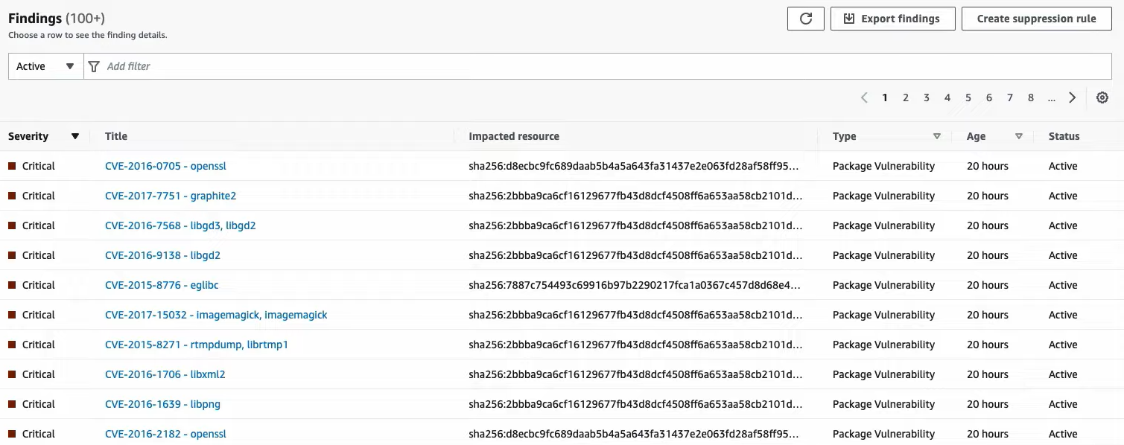
Inspector Service
Possibility to send notifications to SNS
Finding types: EC2 instances, images (ECR)
Support multi-account with Organization service
Price: 15 days trial, https://aws.amazon.com/inspector/pricing
Tutorial: https://docs.aws.amazon.com/inspector/latest/user/what-is-inspector.html

Slide 30
Inspector Service
Demo
  https://www.youtube.com/watch?v=RLBE4Tv7OJE
  https://www.youtube.com/watch?v=Nx8s7lwapoE

Slide 31
Assignment
  Self-practice

Slide 32
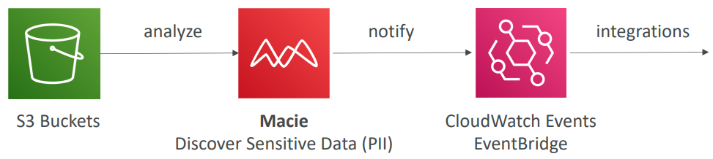
Macie Service
Is a fully managed data security and data privacy service
Using machine learning and pattern matching to
  Discover and protect your sensitive data in S3 at scale (Ex: personally identifiable information)
  Alert to sensitive data
Tutorial: https://docs.aws.amazon.com/macie/latest/user/what-is-macie.html

Slide 33
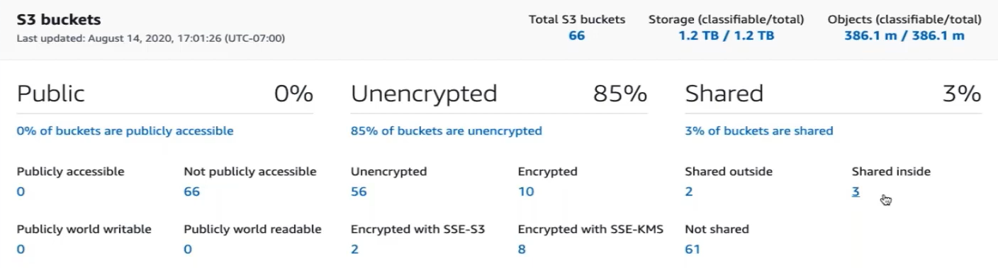
Macie Service
  Providing: unencrypted buckets, publicly buckets, buckets shared with AWS accounts outside
Can setup CloudWatch Event to be notified in case of findings
Support multi-account with Organization service
Price: 30 days trial, https://aws.amazon.com/macie/pricing

Slide 34
Macie Service
Demo
https://www.youtube.com/watch?v=8piwEQJJXdo

Slide 35
Assignment
  Self-practice

Slide 36
Shared Responsibility Model
AWS responsibility - Security of the Cloud
  Protecting infrastructure (hardware, software, facilities, and networking) that runs all the AWS services
  Managed services like S3, DynamoDB, RDS, ...
Customer responsibility - Security in the Cloud
  For EC2 instance, customer is responsible for management of the guest OS (including security patches and updates), firewall & network configuration, IAM
  Encrypting application data
Shared controls
  Patch Management, Configuration Management, Awareness & Training

Slide 37
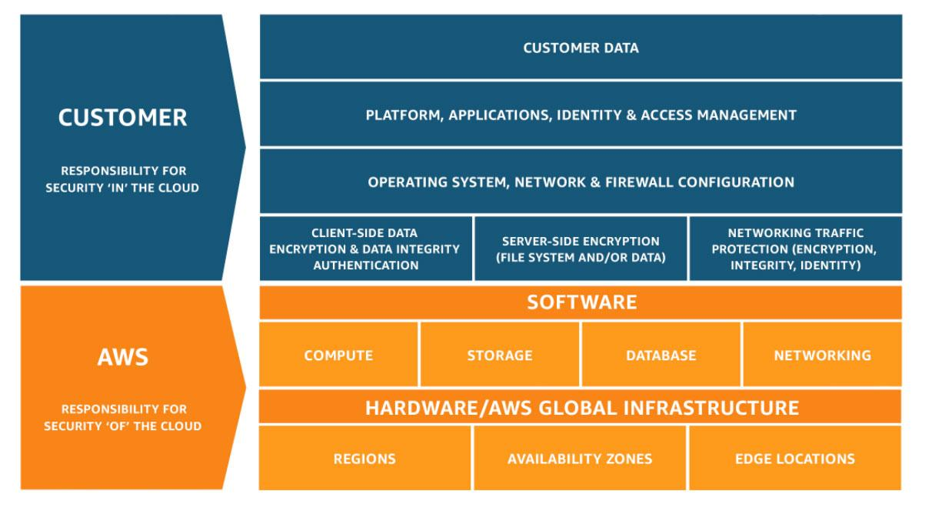
Shared Responsibility Model
https://aws.amazon.com/compliance/shared-responsibility-model

Slide 38
Shared Responsibility Model
Example 1: RDS
  AWS responsibility
    Manage the underlying EC2 instance, disable SSH access
    Automated DB patching
    Automated OS patching
    Audit the underlying instance and disks & guarantee it functions
  Your responsibility
    Check the ports / IP / security group inbound rules in DB’s SG

Slide 39
Shared Responsibility Model
    In-database user creation and permissions
    Creating a database with or without public access
    Ensure parameter groups or DB is configured to only allow SSL connections
    Database encryption setting

Slide 40
Shared Responsibility Model
Example 2: S3
  AWS responsibility
    Guarantee you get unlimited storage
    Guarantee you get encryption
    Ensure separation of the data between different customers
    Ensure AWS employees can’t access your data
  Your responsibility
    Bucket configuration, Bucket policy / public setting, IAM user and roles, Enabling encryption

Slide 41
Q & A
Copyright © VTI Academy All Rights Reserved

